Slide 1
Older People’s Mental Health in NSW
MHCC Presentation
Advocates and Allies
November 2022

Slide 2
OPMH Policy Unit
Setting the scene – what is the role of the
NSW OPMH Policy Unit?
How do we include the voices of older people
with lived experience and their carers in service
planning, delivery and evaluation?
How do we build capability and capacity with our
partners

Slide 3
Older people’s mental health
Some older people develop a mental illness as they age; others grow older with a mental illness that developed earlier in their lives
Depression, anxiety disorders, schizophrenia and other psychotic illnesses, bipolar disorder are key mental health issues for older people, along with alcohol and substance misuse disorders
Ageing brings increased risk of dementia; behavioural and psychological symptoms of dementia (BPSD) common
Suicide is a significant risk issue for older people, particularly older men, and depression is an important risk factor for suicide in later life
As NSW population ages, number of older people with mental illness projected to increase significantly to approx. 260,000 in 2026
Differences in presentations in older people and co-occurrence with physical illness; stigma & under-recognition but MH treatment effective

Slide 4
OPMH services across NSW

Slide 5
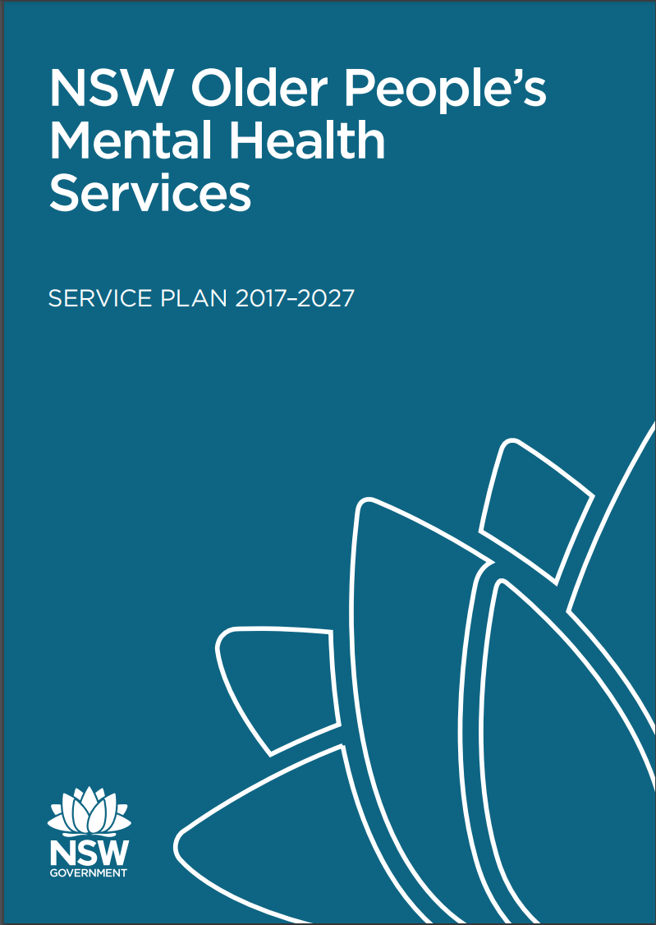
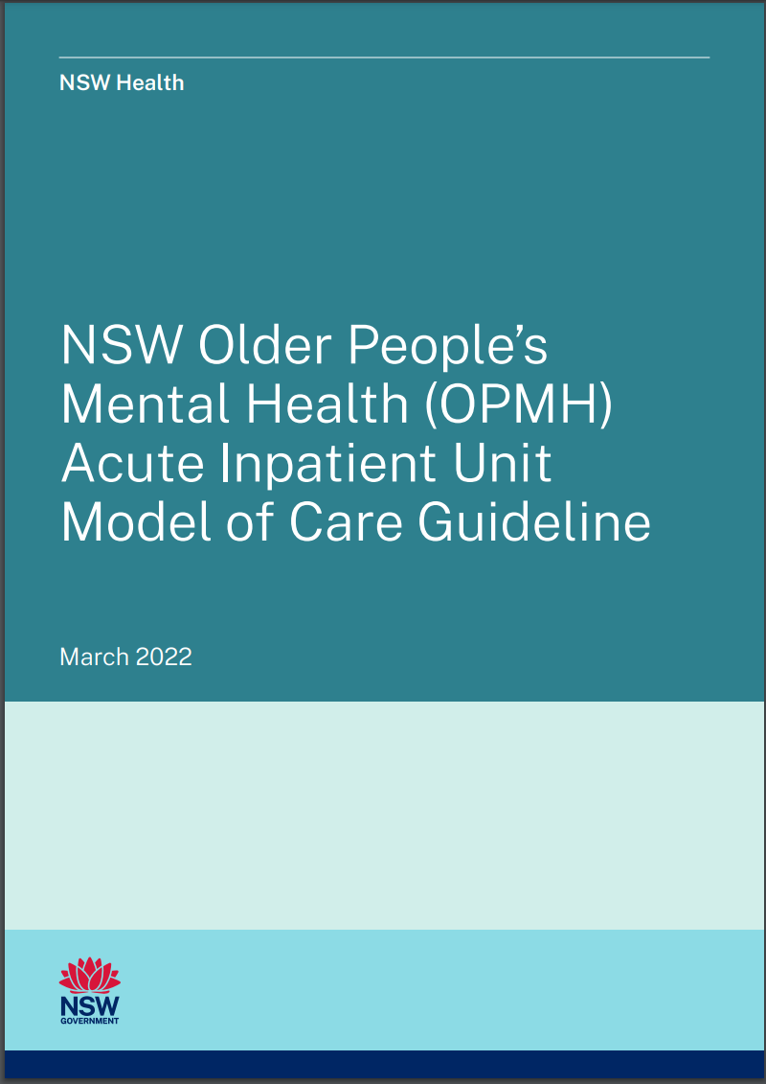
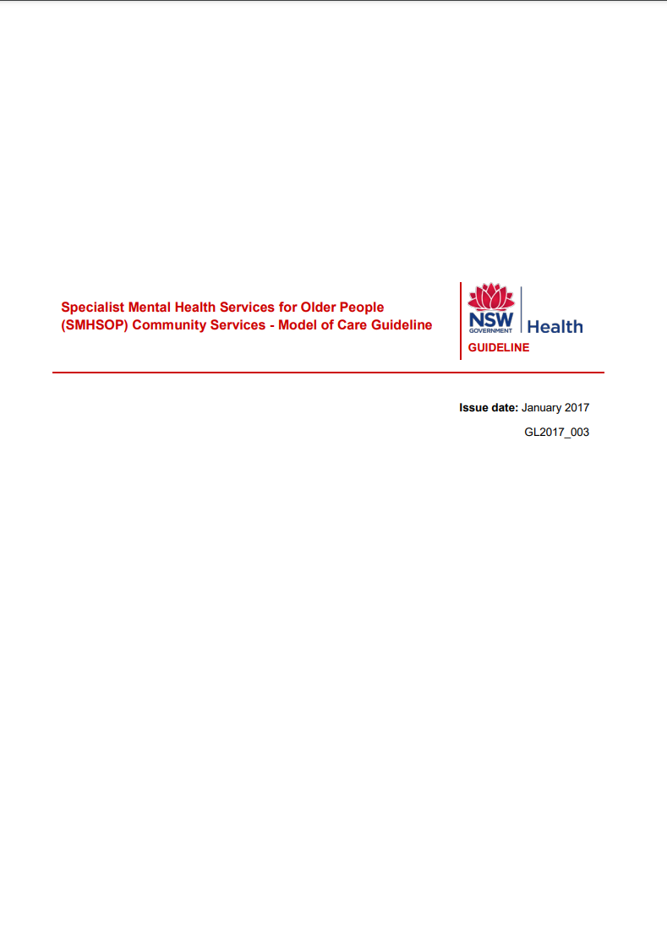
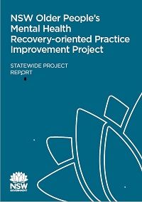
The voice of consumers in OPMH Policy work
NSW OPMH Service Plan 2017-2027
NSW OPMH Inpatient Model of Care Guideline (GL2022_003)
SMHSOP Community Model of Care Guideline (GL2017_003)
OPMH Physical Health practice improvement project report (to be published 2023)
NSW Older People's Mental Health Recovery-oriented Practice Improvement Project - Statewide Project Report
Pathways to Community Living – Stage One Evaluation Report (2021)

Slide 6
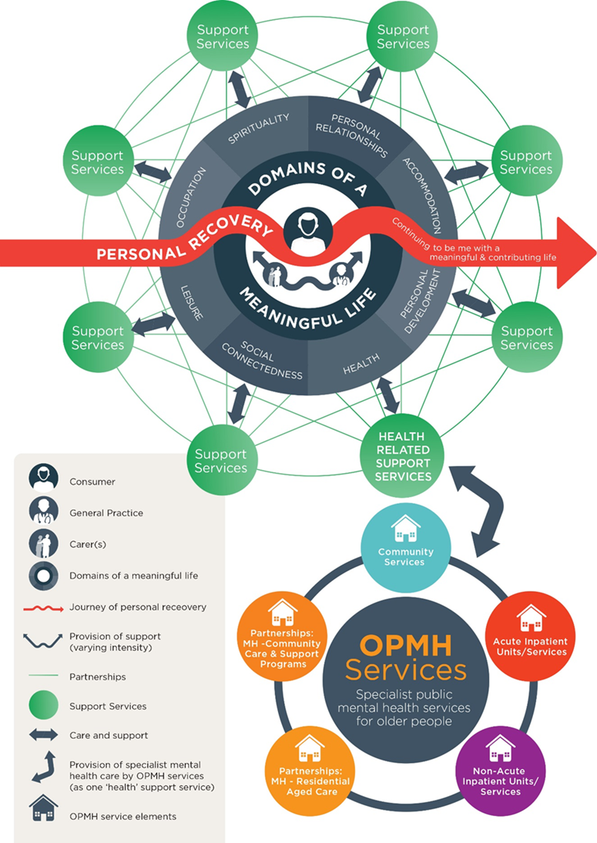

Slide 7
OPMH Service Plan consultations – Key themes

Slide 8
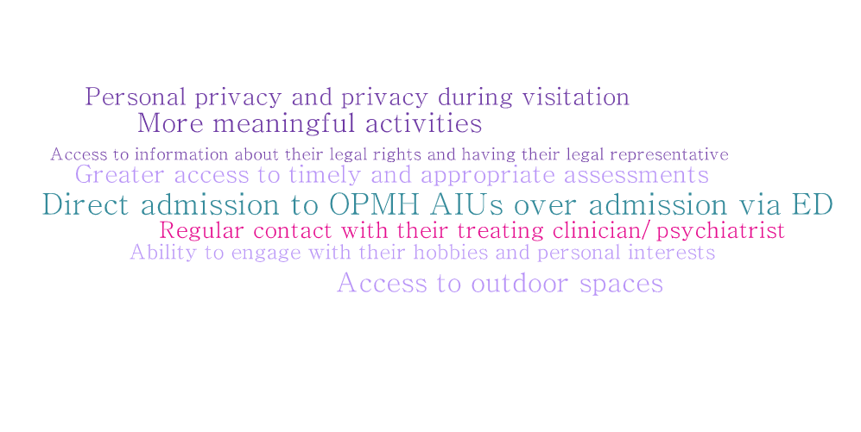
AIU MoC Guideline consumer/carer voice
Factors from the consultation about what was important to consumers and carers

Slide 9
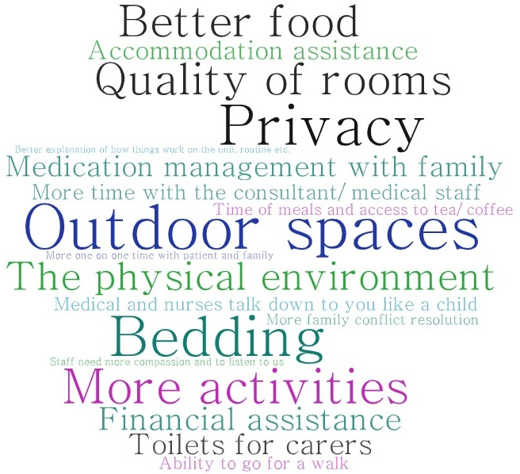
AIU MoC Guideline consumer/carer consultation findings
Aspects of the unit's design and care that could have been better

Slide 10
OPMH Recovery project
Project aimed to promote recovery-oriented practice in NSW OPMH community and inpatient teams across NSW by supporting services to translate policy into practice improvement, adopting a ‘start where you can’ approach
Thirteen projects across 11 LHDs progressed to final completion
Co-design and consumer involvement was central to the development of the project at the state level as well as in most of the LHD projects.
McKay Roderick, Jackson Kate, Stevens John (2022) Implementing recovery-oriented practice in older people’s mental health services: the NSW experience. Australian Health Review 46, 426-431

Slide 11
The project methodology was seen as highly successful, resulting in ongoing service improvements
OPMH peer workforce development
Co-design and consumer involvement
The methodology was the genesis of the Physical Health project and laid a strong foundation for future translational research and practice improvement in OPMH

Slide 12
OPMH Physical Health Project
This state level project sought to support stakeholders in developing and implementing practice improvements to enhance the physical health outcomes for older people with a mental illness. The project has successfully progressed 8 translational research projects across 11 LHDs, supporting teams to translate policy into practice.
Most projects adopted a co-design methodology with consumers and carers or had peer workers and consumer consultants directly involved in implementation.

Slide 13
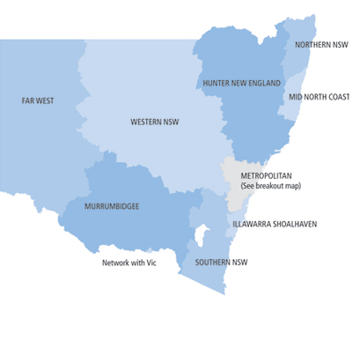
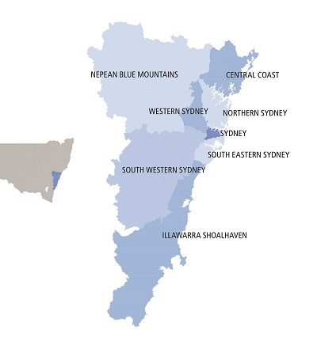
Participating teams across NSW

Slide 14
Physical health project outcomes
SVHN, Mid-North Coast and Southern NSW | NEAMI physical health prompt | Tool is still being utilised and piloted across multiple LHDs.
Nepean Blue Mountains LHD | Flourish physical health prompt | Pilot is ongoing, successful in initiating conversations
South Western Sydney LHD | LIVE WELL: empowering positive lifestyle change in consumers | A suite of education modules designed to empower consumers have been developed and rolled out across the LHD
Western NSW LHD | Fit for your Life: Redefining Mental Health Treatment in rural Australia | Pilot was a success and project has progressed to publication
Northern Sydney LHD | Screening of comorbidity in the older mental health consumer | Sustained change in LHD screening processes >75% of consumers
Western Sydney LHD | Exercise a key determinants of holistic health improvement program pilot testing initiative | Pilot was a success with ongoing OPMH group programs planed
South Eastern Sydney LHD | OPtiMHise: Optimising the health and lifestyle factors of consumers accessing the Older People’s Mental Health Service | Developed a screening tool and health pathways to support consumers on most commonly identified issues
Illawarra Shoalhaven LHD | Manage My Health: a coaching approach to assist older mental health consumers to better manage their own physical health needs | A co-design consumer coaching model has been adopted by the LHD for OPMH services

Slide 15
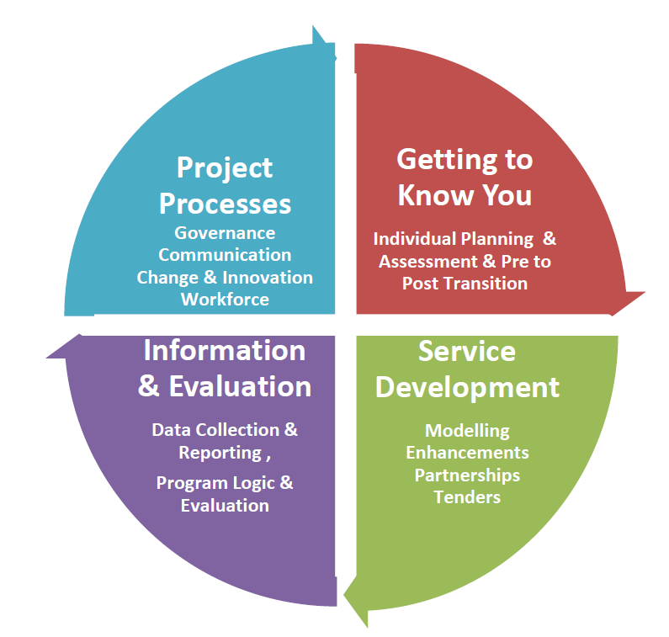
Pathways to Community Living

Slide 16
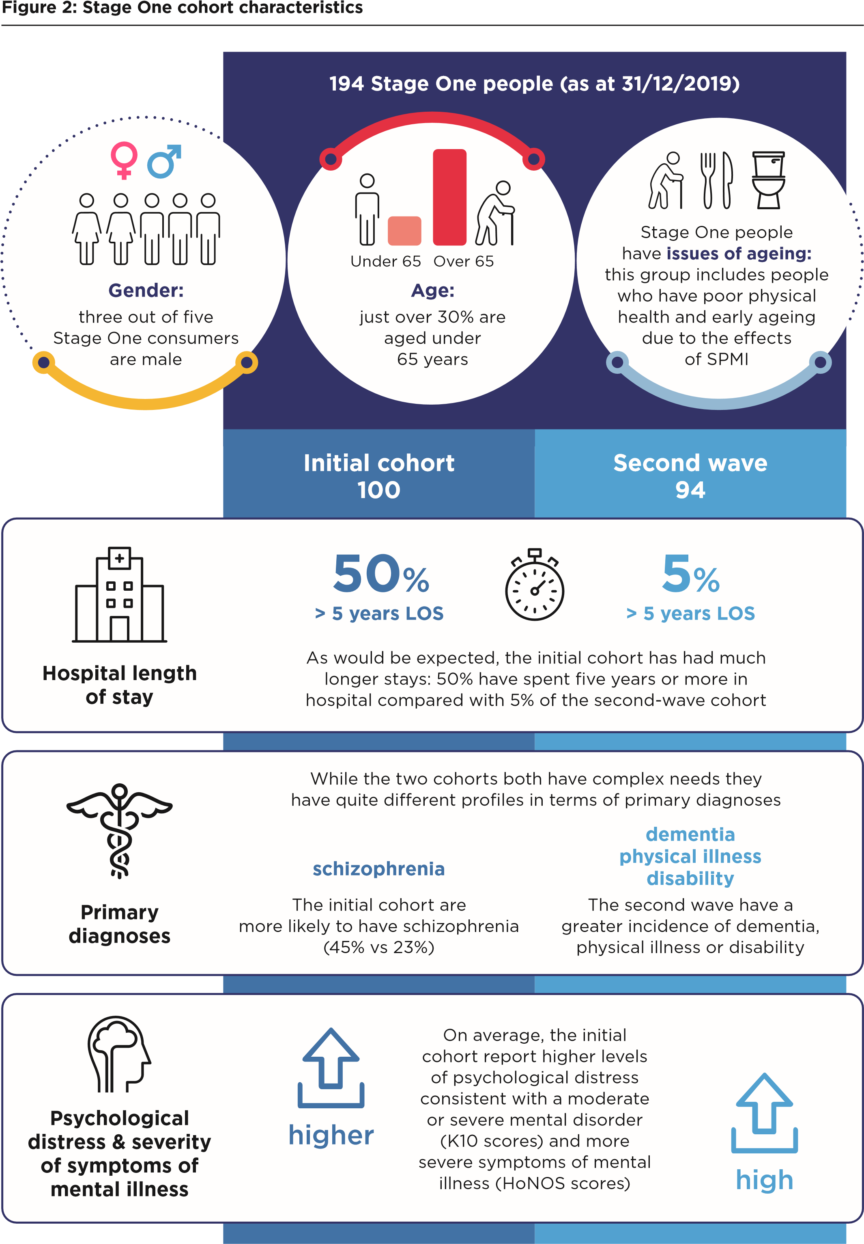
The target group: Stage One
People with complex mental health needs (including SPMI and severe behavioural & psychological symptoms of dementia) and aged care needs
Includes people over 65 years and people under 65 years with early ageing issues
Stage Two is for people 18 years upwards with SPMI and complex needs, without ageing issues

Slide 17
Key drivers and enablers 2014 onwards
Key recommendation of Living Well report (MH Commission of NSW) and recognition of complex needs of people with severe and persistent mental illness (SPMI) experiencing long hospital stays – small but significant population
Strong evidence that these people experience better quality of life and improved health and social outcomes if they are well supported in the community
Strong foundations - for Stage One - NSW Older People’s Mental Health (OPMH) Program, innovative service models, aged care providers
Clear program objectives to:
Transition long-stay patients (and those at risk of long-stays) with SPMI and complex needs into appropriate community settings including development of additional, recovery-oriented services
Change practice to improve pathways into community care, and reduce long hospital stays for this group
Major commitment and leadership from the Ministry, Local Health Districts and aged care partner organisations

Slide 18
The PCLI approach
The Health Information exchange (HIE) data below from the Quarterly Census Reports looks at trends for people over 365 days (certain parameters are used such as excluding Forensic Unit Patients as they are subject to legal provisions).The downward trend in number, total LOS and Avg LOS indicates that the focus of LHDs, including the work of PCLI, on long-stay patients could be seen as a contributor to these favourable data.
Focussed on the person’s individual journey, and
supported by mental health clinical teams
Planning your move
Making your move
Your community life

Slide 19
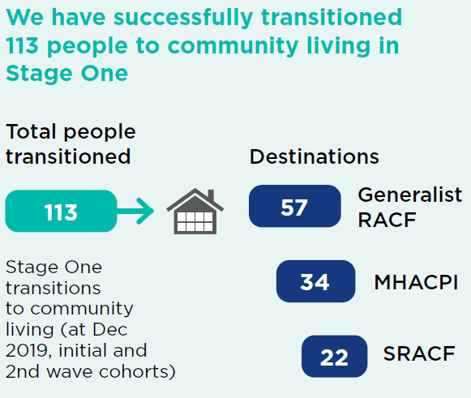
Successful transitions to community living
3 aged care partnership models:
Generalist residential aged care facilities (RACF)
Specialist MHACPI transition unit in RACF
Specialist RACF

Slide 20
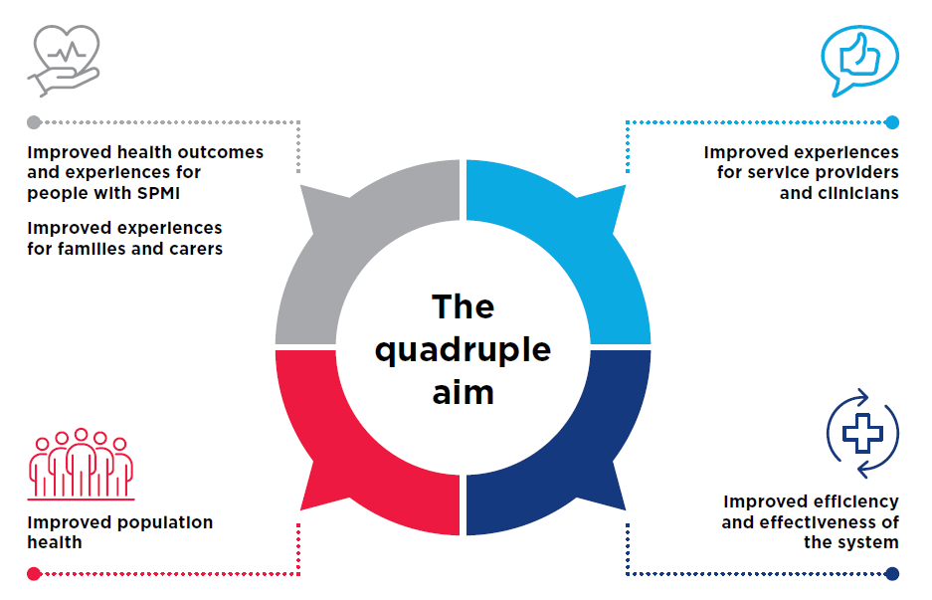
What did the evaluation and data tell us?

Slide 21
Improved experiences for people with SPMI and families
Positive health outcomes incl. reduced psychological distress & improved life skills
Low need for unplanned acute care – people are doing well in the community
Improved engagement, choice and control in people’s lives after transition
Carers can see loved ones having a more meaningful life
Improved experiences for service providers and clinicians
A cultural change is evident towards ‘recovery’ and coordinated complex care
Effective engagement across hospital and community and aged care settings
Improved efficiency and effectiveness of the system
Successful transitions and increased bed capacity for newer population groups
Reduction of around 33% in total length of stay (LOS) and average LOS across all NSW beds
Economic analysis shows large reduction in av. costs between $12M & $18M / year
Capacity to re-shape mental health non-acute inpatient models – no longer ‘homes’

Slide 22
Improved experiences for people with SPMI
The Health Information exchange (HIE) data below from the Quarterly Census Reports looks at trends for people over 365 days (certain parameters are used such as excluding Forensic Unit Patients as they are subject to legal provisions).The downward trend in number, total LOS and Avg LOS indicates that the focus of LHDs, including the work of PCLI, on long-stay patients could be seen as a contributor to these favourable data.

Slide 23
Improved experiences for families and carers
The Health Information exchange (HIE) data below from the Quarterly Census Reports looks at trends for people over 365 days (certain parameters are used such as excluding Forensic Unit Patients as they are subject to legal provisions).The downward trend in number, total LOS and Avg LOS indicates that the focus of LHDs, including the work of PCLI, on long-stay patients could be seen as a contributor to these favourable data.

Slide 24
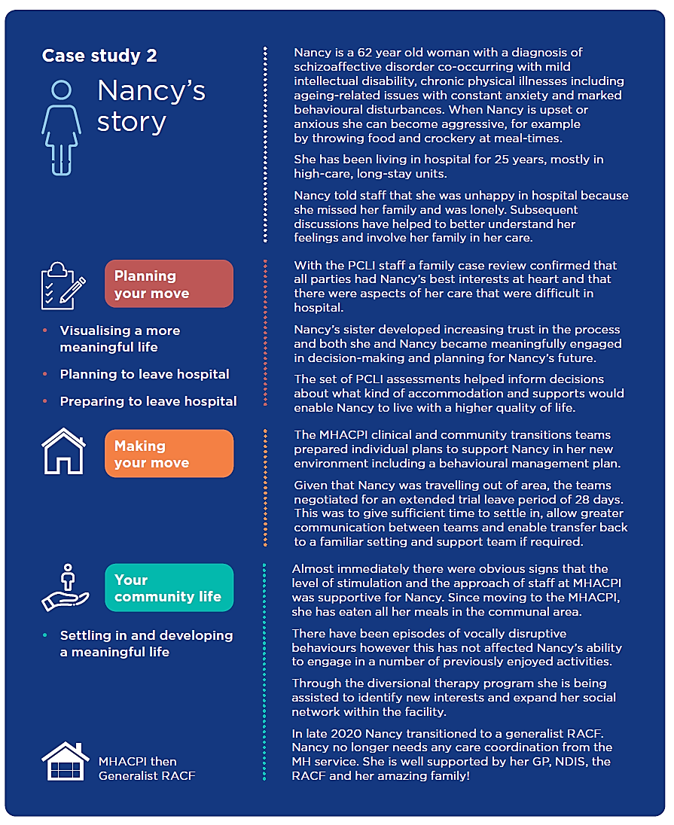
Nancy’s story

