Slide 1


Supporting Community Connection
How can you help people living with mental health challenges to live more fulfilling lives in the communities of their choice?
Webinar 3/3 – 10 June 2020
10:30 – 11:30 AM

Slide 2
I would like to acknowledge the traditional custodians of this land and pay my respect to elders past and present.

Slide 3

Pre-webinar poll
How familiar are you with this MHCC project?
Not at all
A little
Somewhat
Very

Slide 4
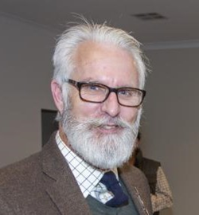
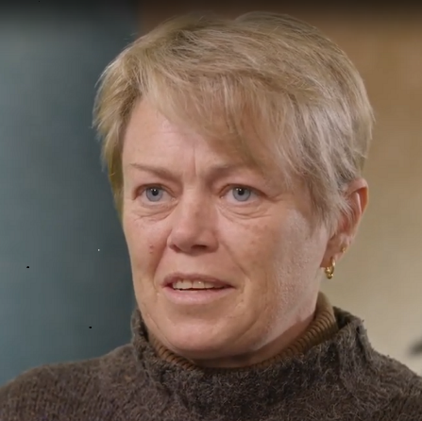
Panelists
Mark Noble, Lived Experience Representative, Western NSW/Dubbo
Susan Allen (Sue), Lived Experience Representative, Sydney
Launch
Carmel Tebbutt, MHCC CEO

Slide 5

‘Supporting Community Connection’ (CEEP Project)
‘Supporting Community Connection’ for people living with mental health conditions outside of a funded NDIS package
For people who are ineligible for, or do not want to have, NDIS funded services and supports
Will also benefit people with NDIS funded services and supports

Slide 6
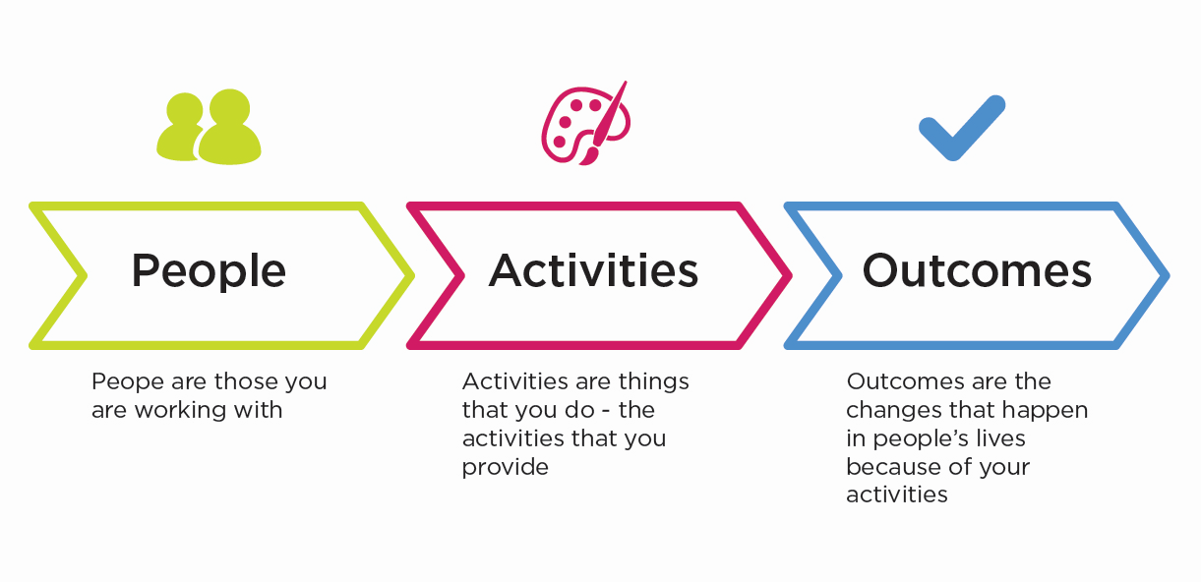
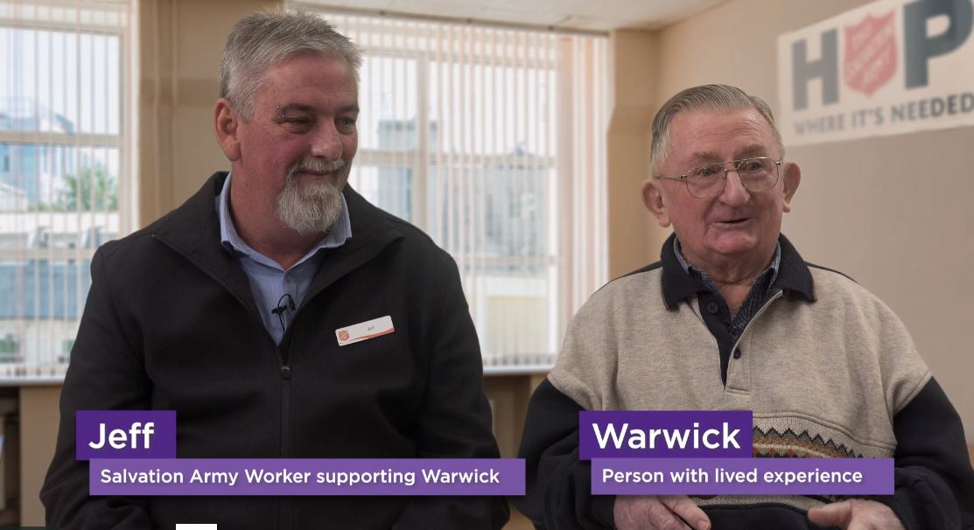
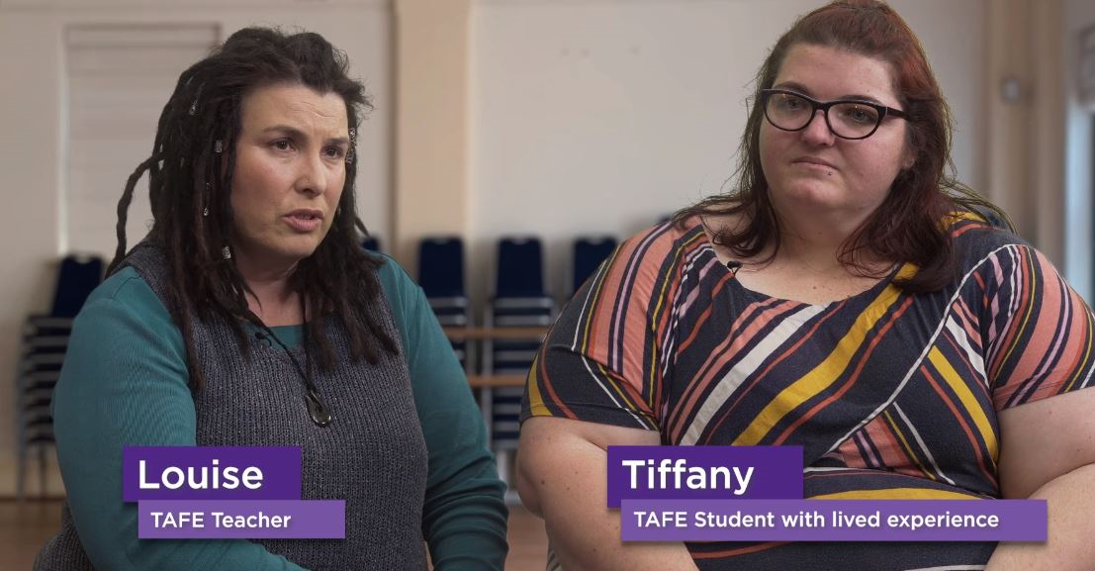
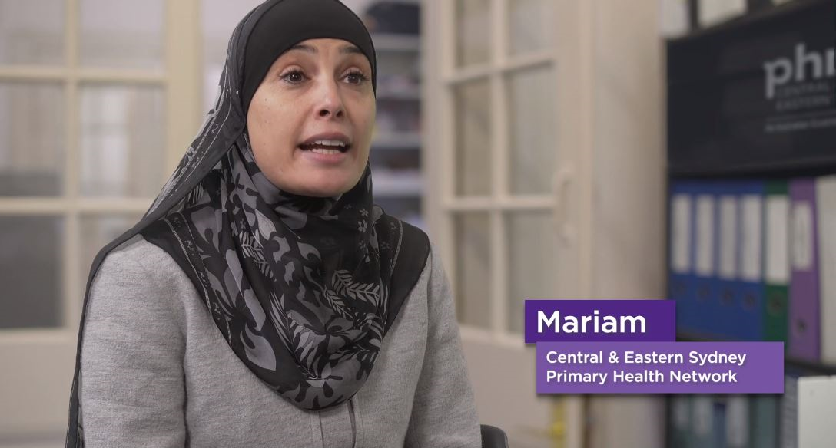
ILC – people, activities & outcomes

Slide 7
Project outcomes
People living with, or at risk to develop, psychosocial disability :
participate in and benefit from the same community activities as everyone else
are connected and have the information they need to make decisions

Slide 8



Slide 9







Six key topics

Slide 10
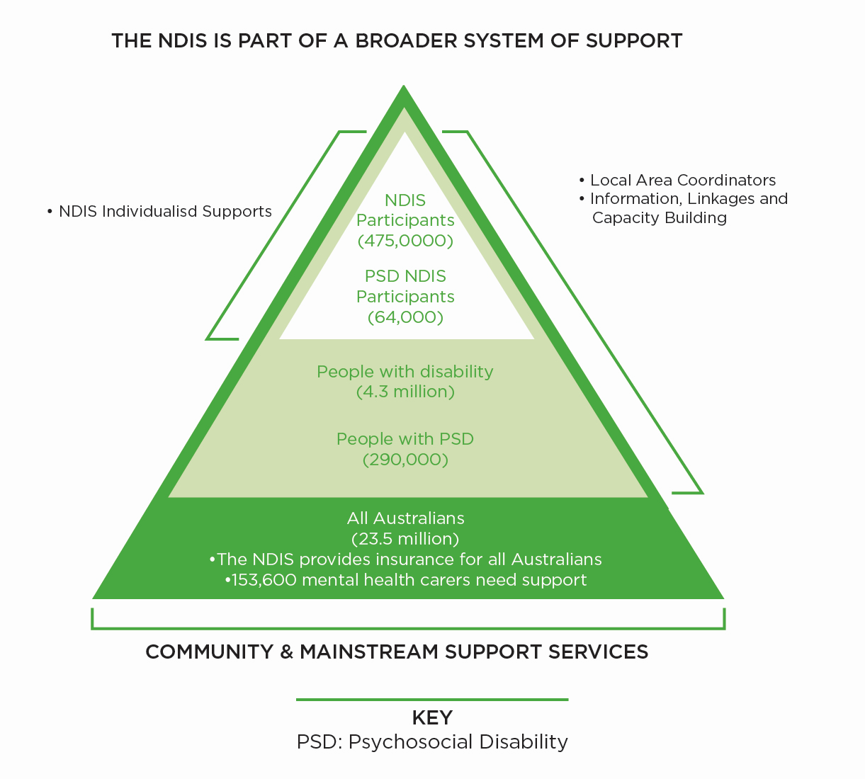

Slide 11

Panel & viewer questions/comments
Can you describe for us a moment or two across the two years of the project that had meaning for you?

Slide 12

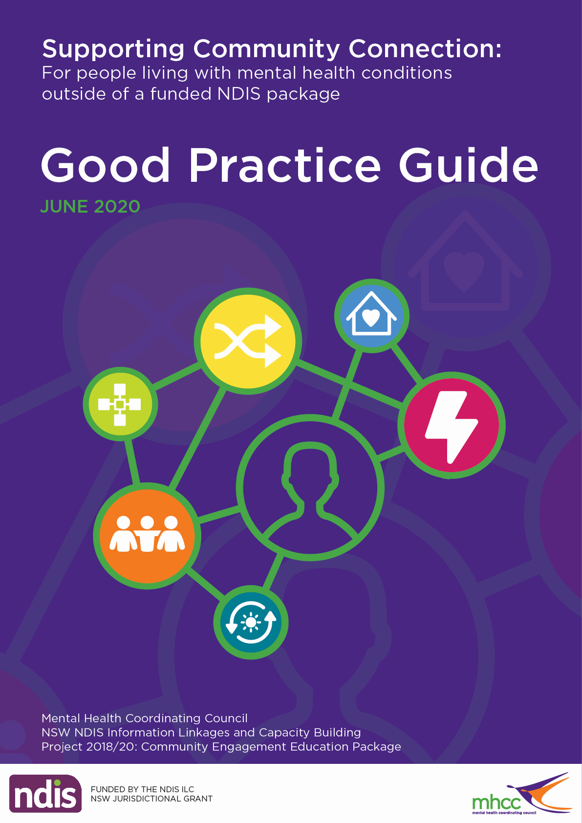
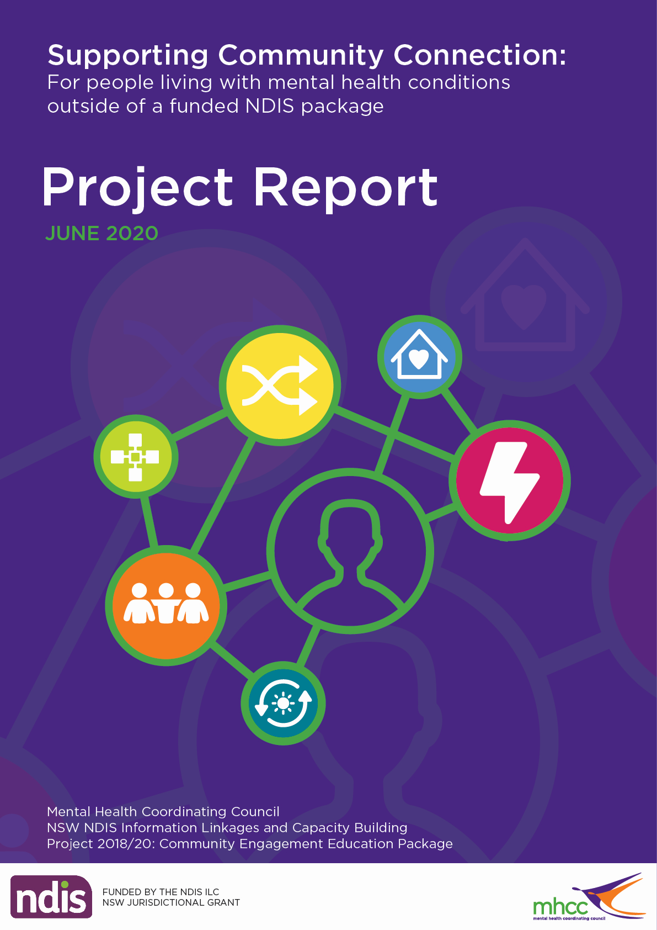
Learning Materials
Videos – 5 minutes
PPT Presentations – 15 slides
Facilitator/Trainer Guides – 10 pages
‘Good Practice Guide’ & ‘Project Report’

Slide 13
Panel question 1
What have been the most interesting parts of the learning materials for you?

Slide 14
Panel question 2
What would you suggest to encourage people to use the learning materials?

Slide 15
Panel & viewer question 3
What has been your experience of co-design of learning materials?

Slide 16
Panel & viewer question 4
Do you think that co-design can help improve the quality of the learning materials?

Slide 17
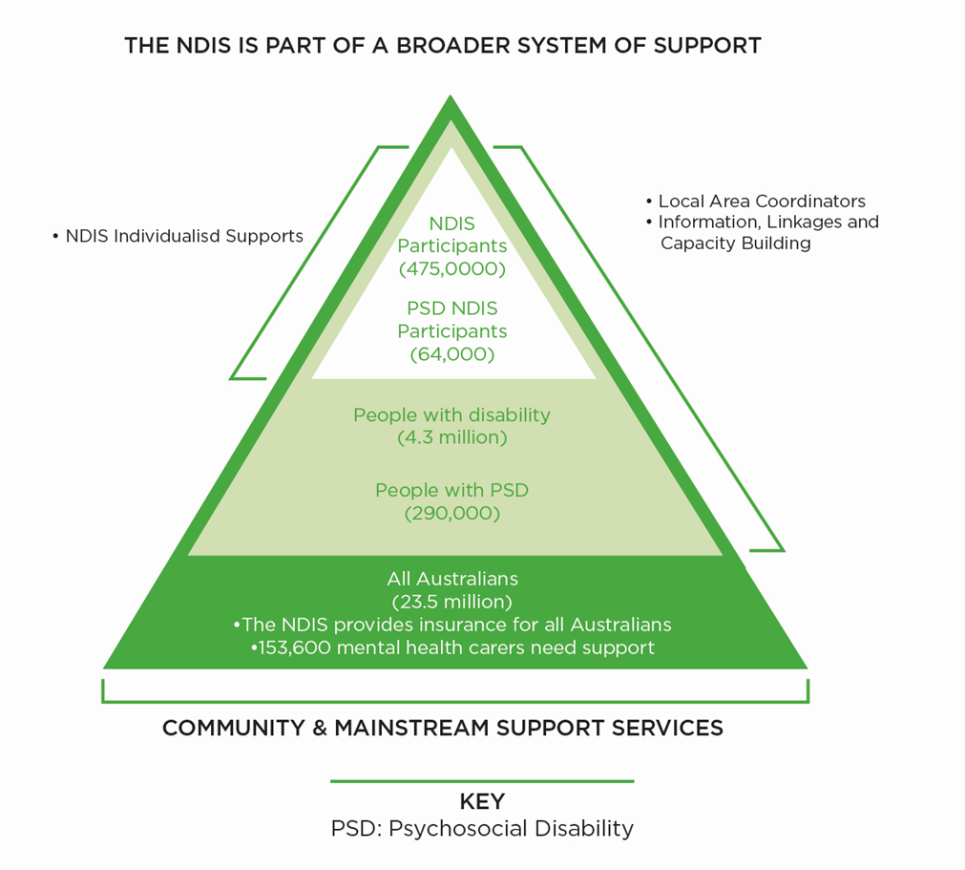
LAUNCH OF LEARNING MATERIAL

Slide 18
LAUNCH OF LEARNING MATERIAL
Aligned to 6 key topics
Videos (and others)
Power Point Presentations
Facilitator/Trainer Guides
Good Practice Guide

Slide 19

Good Practice Guide
Table of Contents
Why Did MHCC Develop a Good Practice Guide?
What Are The ‘Supporting Community Connection’ Learning Materials?
Using the Learning Material
Provide Feedback

Slide 20
Post-webinar poll
How familiar are you with this MHCC project?
Not at all
A little
Somewhat
Very

Slide 21




Thank you
Project Partners
Co-design Working Group Participants
Advisory Group
Monitoring and Evaluation Working Group
Production Partners
Video participants & In the Thicket
University of Sydney
Webinar participants & Redback Connect
National Disability Insurance Agency
MHCC team

Slide 22
THANK YOU
Would your organisation
benefit from becoming an MHCC member or other MHCC Learning
and Development training?
Enquire today:
info@mhcc.org.au
training@mhcc.org.au
Or visit: mhcc.org.au

